Slide 1


Sentimental Analysis Using Twitter and Text data
Prepared By:
Shivani Desai(17dce007)
Helina Gandhi(17dce08)
Janviba Jhala(17dce016)
Under Guidance of:
Ms. Dweepna Garg
(Assistant Professor)

Slide 2
Outline:
Abstract
Objective
What is Sentimental Analysis?
Motivation
Sentimental analysis on twitter data
Programming tools and Hardware
Flowchart
Implementation and Screenshots
Conclusion
Reference

Slide 3
Abstract
The purpose of this project is to build an algorithm that can accurately classify Twitter messages as positive or negative, with respect to a query term.
Our hypothesis is that we can obtain high accuracy on classifying sentiment in Twitter messages using machine learning techniques.

Slide 4
Objective
Twitter is a popular microblogging service where users create status messages (called "tweets").
These tweets sometimes express opinions about different topics.
Generally, this type of sentiment analysis is useful for consumers who are trying to research a product or service, or marketers researching public opinion of their company

Slide 5
Sentimental Analysis
Sentiment Analysis is the process of determining whether a piece of writing is positive, negative or neutral.
Also referred to as opinion mining, it makes our goal to determine whether the data(tweet) is positive, negative or neutral.

Slide 6
Motivation
Consumers can use sentiment analysis to research products and services before a purchase.
Production companies can use the public opinion to determine acceptance of their products and the public demand.
Movie-goers can decide whether to watch a movie or not after going through other people’s reviews.

Slide 7
Sentimental analysis on twitter data
Social networks is a rich platform to learn about people’s opinion and sentiment regarding different topics as they can communicate and share their opinion actively on social medias including Facebook and Twitter.
This survey focuses mainly on sentiment analysis of twitter data which is helpful to analyze the information in the tweets where opinions are highly unstructured, heterogeneous and are either positive or negative, or neutral in some cases.

Slide 8
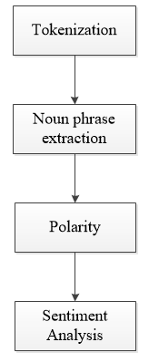
Workflow of Sentiment Analysis

Slide 9
Programming Tools and Hardware
BASIC HARDWARE NEEDS
Intel Core i3
7th Generation
PROGRAMMING TOOLS
Python
Flask
Bootstrap
Html
CSS

Slide 10
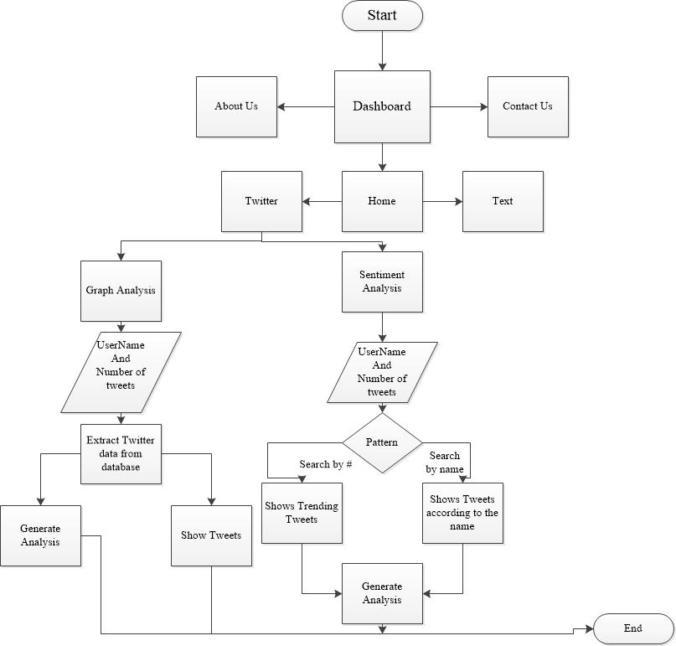
Flowchart

Slide 11
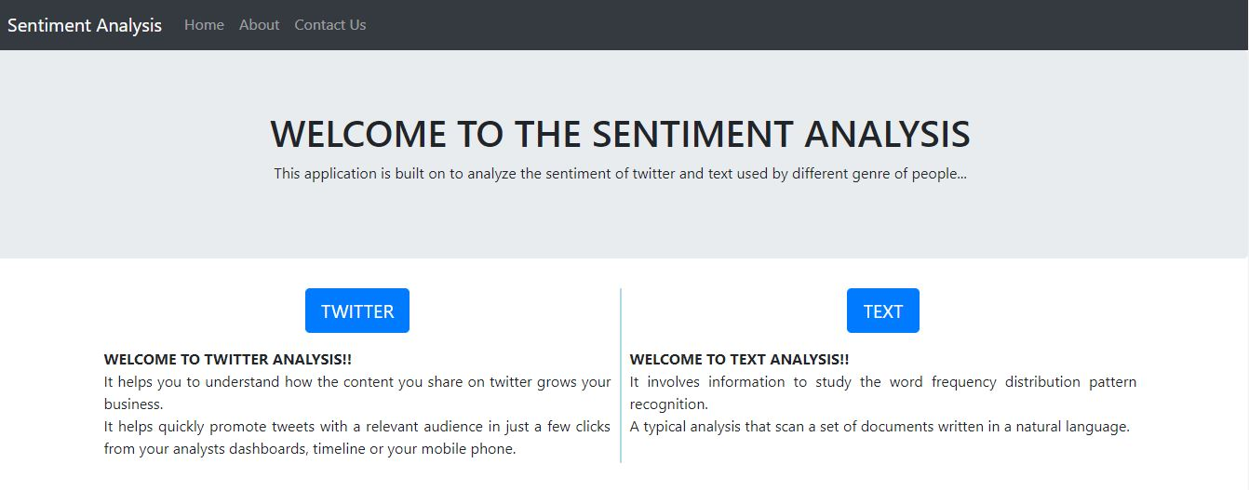
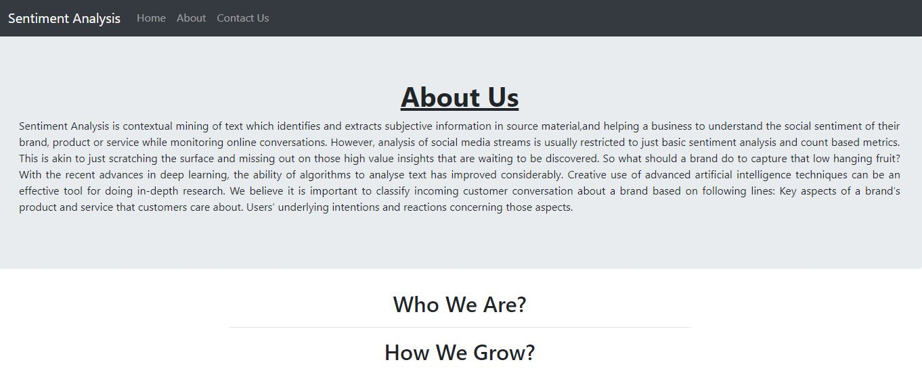
Implementation Screenshots

Slide 12
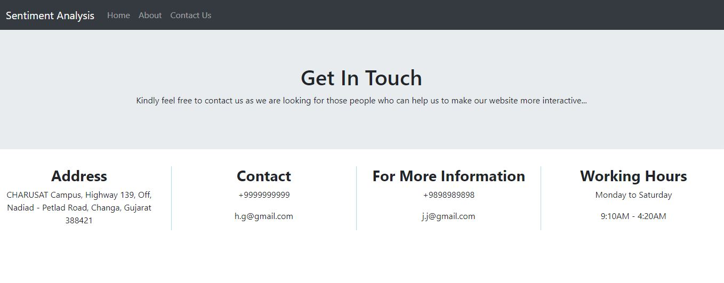
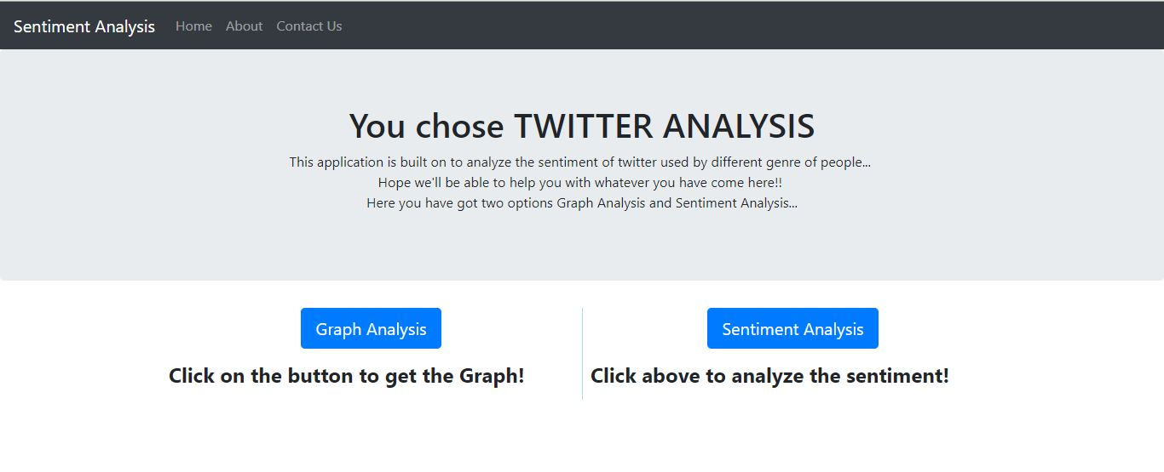
Implementation Screenshots

Slide 13
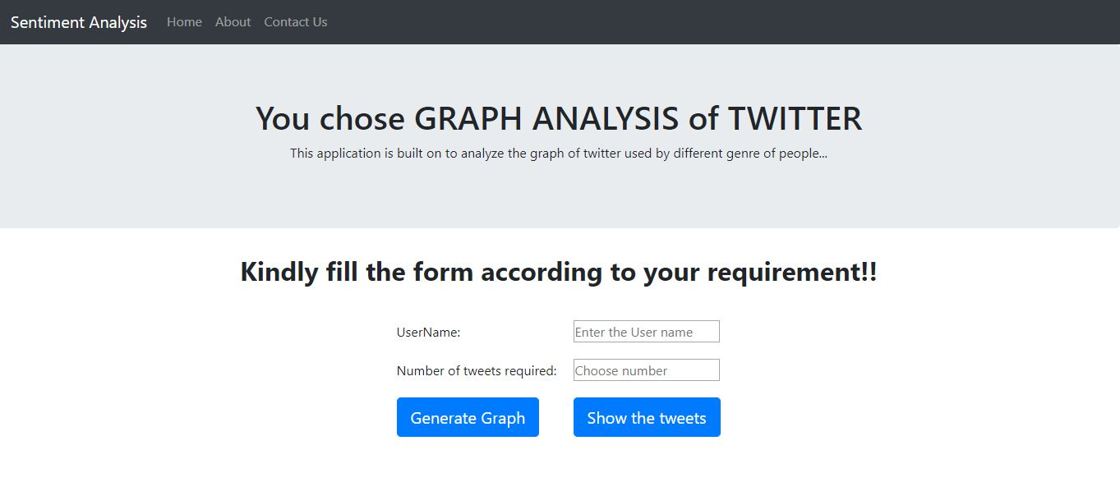
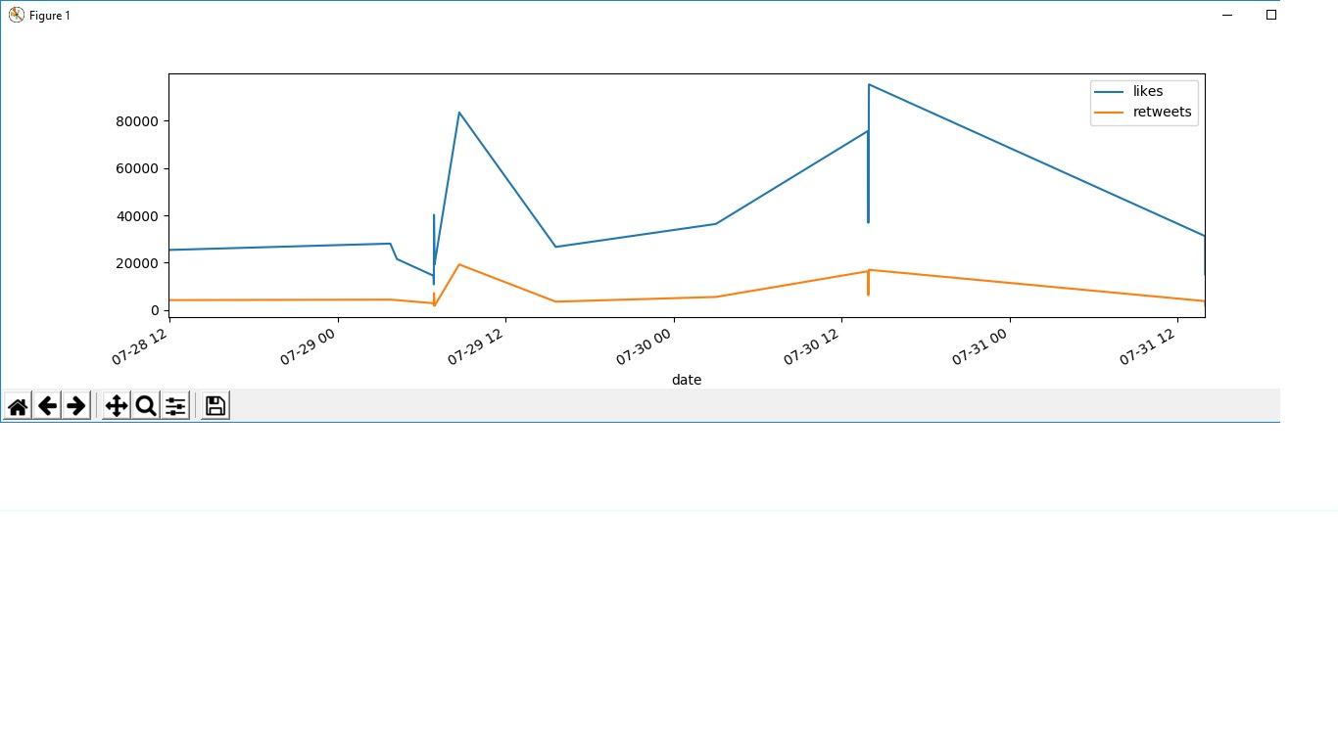
Implementation Screenshots

Slide 14
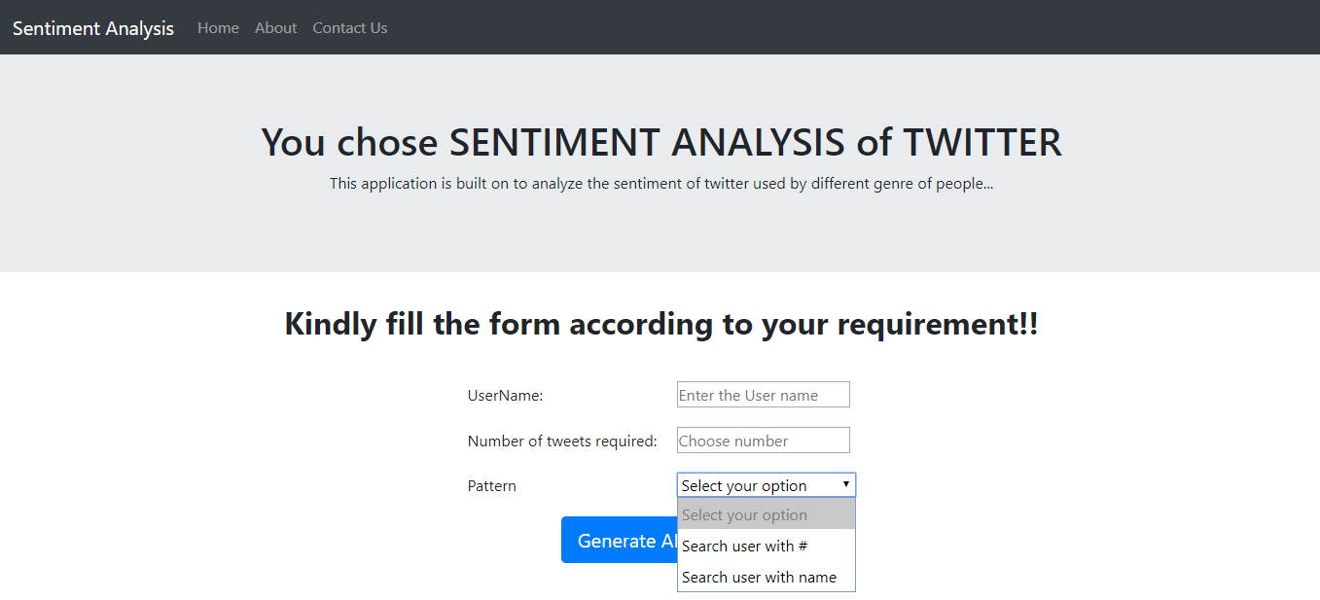
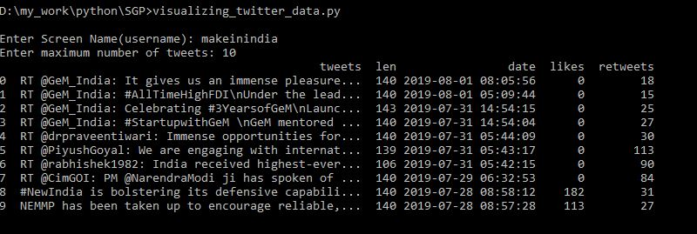
Implementation Screenshots

Slide 15
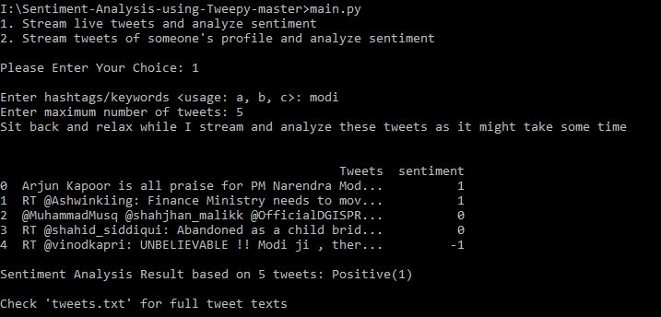
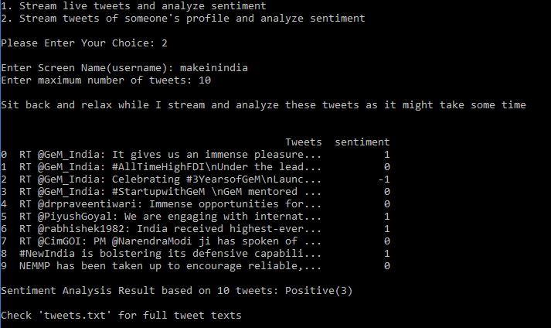
Implementation Screenshots

Slide 16
Conclusion
Here we concluded by determining the positivity and negativity of each tweets.
Based on this tweets we represented them in the form of line graph.
In Future work, we will explore sentiment analysis on text data in which user can enter any text and analysis will be performed as positive ,negative or neutral.

Slide 17
Reference
https://www.geeksforgeeks.org/twitter-sentiment-analysis-using-python/
https://opensource.com/article/17/3/python-flask-exceptions
https://www.youtube.com/watch?v=wlnx-7cm4Gg
https://www.geeksforgeeks.org/python-introduction-to-web-development-using-flask/
https://www.geeksforgeeks.org/python-404-error-handling-in-flask/

